Slide 1
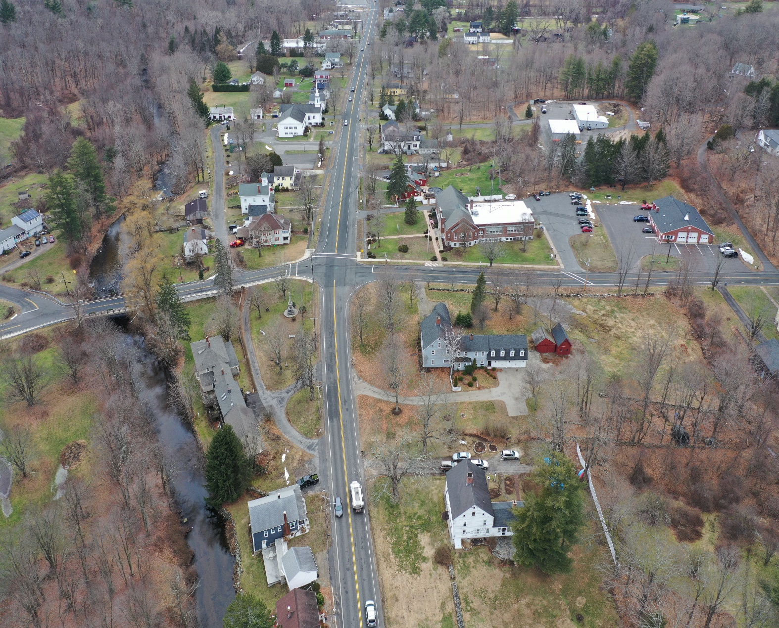
The Town of Hampden Prepares for Severe Weather Threats
Learn how the Town is building resilience to flooding and severe storms.
March 21, 2023
7:00 PM
Town Hall Auditorium
625 Main St, Hampden, MA 01036
Zoom: virtualmeeting.link/mvp-project-concepts-hampden
The Town is holding a hybrid public meeting (online and in-person) to present the Top 10 projects designed through the Municipal Vulnerability Preparedness Program. The project team will give a short presentation followed by a public comment session on the Top 10 project concepts.
For more information, contact:
Taylor Miller – tmiller@hshassoc.com

